Slide 1

One Lifetime Conversation
with your Customers
PIVOTING AROUND SYSTEMS OF ENGAGEMENT TO TRANSFORM BUSINESS AND GROW REVENUE
DATE 2014

Slide 2




Consumers are embracing digital so quickly, companies struggle to keep up.
More connected. More social. More demanding of consistent personal service.

Slide 3

Consumers want a rich omnichannel personalized experience.
$434B
25%
81%
is the expected online retail sales for 2017, growing from $258B in 2013.
will be the share of mobile in total eCommerce sales by 2017
consumers say social posts from their friends directly influenced their decision.
What do customers really want?
Personalization
Omnichannel
Recommendations
Physical store scenarios
59% Consumers want companies to demonstrate that they understand her
61% of consumers want to be able to complete an order online
53% want companies to maintain a cross-channel history of all her purchases
64% want technology-enabled store associates for improved customer service
67% want to be able to pick up an online order in a store
64% want them to know what products or services she likes
59% expect more precise, personalized offers
46% want to use smartphone to locate an out-of-stock item, purchase it, and have it shipped
79% want to receive a delivery notification for an order via any combination of channels
54% want them to know whether she’s a new or returning customer
49% want assistance matching a new purchase to a previous purchase, regardless of the original purchase channel
67% consider slow checkout to be the second most negative in-store experience
Sources: Gartner, IBM Smarter Commerce for Retail, eMarketer

Slide 4

How to meet the need?
Invest in Systems of Engagement
BE THERE
Invest in a rich omni-channel experience
BE RELEVANT
Generate deep understanding of customers from all available sources (single view of customer)
BE ONE STEP AHEAD
Give consumers a uniquely personalized and timely experience to boost satisfaction and loyalty
1-
LIFETIME- CONVERSATION with your CUSTOMER

Slide 5
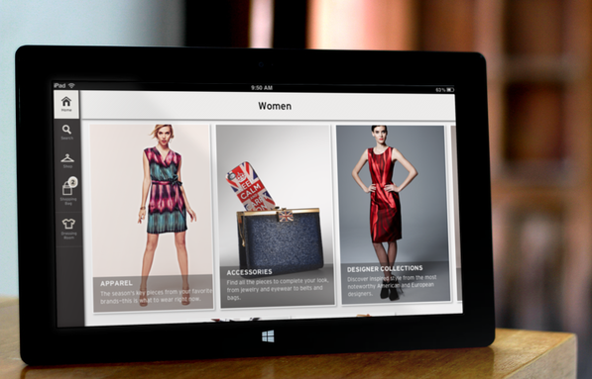
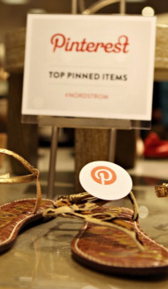

Systems of Engagement
Create a rich omni-channel experience.
iOS, ANDROID, & WINDOWS PHONE COMPANION
83% of top retailers provide at least one mobile offering
Only 1 in 3 of the top retailers has a mobile offering on all three platforms.
TABLET-ENABLED PHYSICAL LOCATIONS
Reps know more about their customer
Persist across staffing schedules
Receive useful recommendations for accessorizing
BEACON TECHNOLOGY
Generate & track in-store traffic analytics (like Web traffic)
Incentivize use with loyalty program or promotional discount calendar
CLOUD INFRASTRUCTURE
Create a roadmap for migration to Cloud-based unified back-end (Web, Mobile, POS, CRM)
Expand global infrastructure to support new markets (China, Singapore etc)
Establish clear privacy & security models

Slide 6

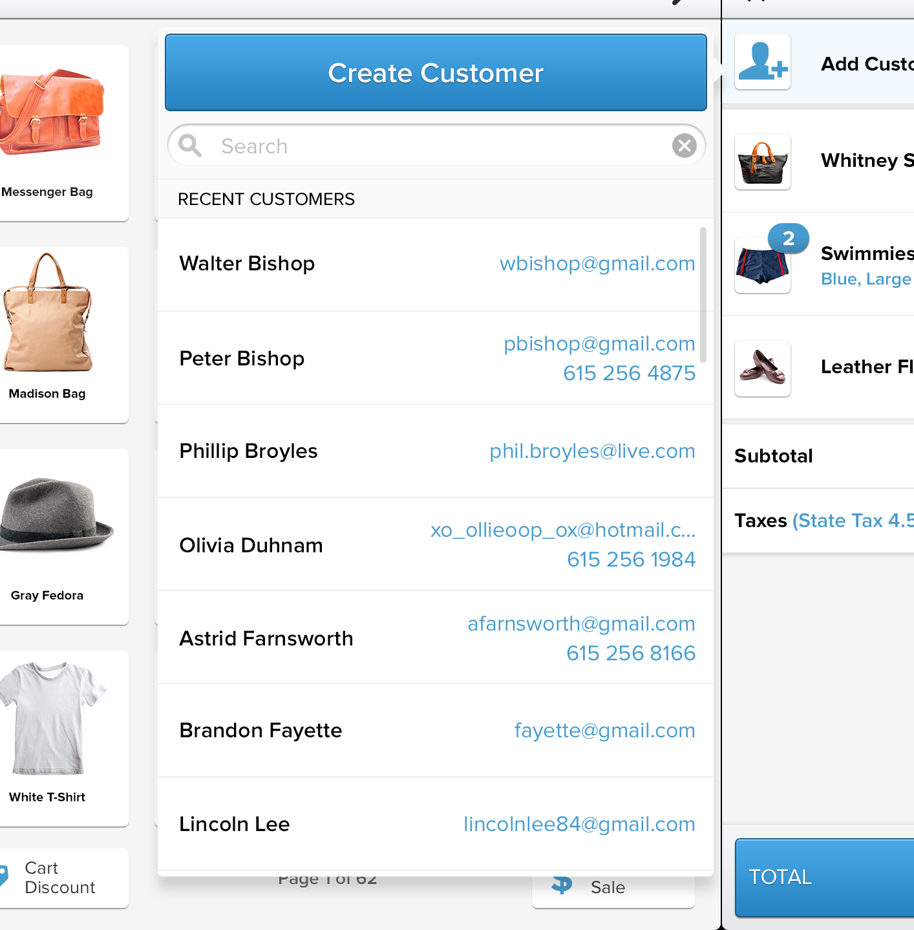

Systems of Engagement
Create a single view of customer.
REFINE CUSTOMER DATA
Establish points of entry and processes for collection
Create processes for integrity, while minimizing consumer intrusion
INTERNAL SYSTEM CONSOLIDATION
(Re)establish means of collection across Web, Mobile, POS as appropriate on Cloud Infrastructure
ENHANCE WITH EXTERNAL SOURCES
Pull Social analytics, Web analytics, and In-store traffic
Append external sources on market-by-market basis
INVEST IN CRM & REPORTING TOOLS
Build out unified CRM experiences for Customer Service, Self-service profile access, and In-store Rep access (e.g. Surface Tablets)
Deploy tools such as Tableau for best of breed dashboards

Slide 7
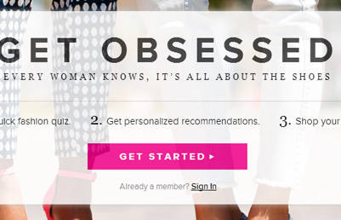
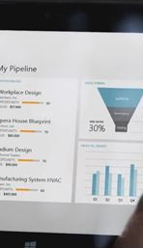

Systems of Engagement
Orchestrate a personalized conversation.
GENERATE EVOLVING PROFILES & SEGMENTATION
Derive meta-data from the Single View of customer
Apply modeling to produce segment-specific value propositions
PERSONALIZE CONTENT DELIVERY
Dynamically generate personalized Web, mobile content
Expand Marketing Campaigns to incorporate dynamically generated offers
Dynamically generate recommendations and cross-sell
IMPROVE ORCHESTRATION
Increase process automation in the CRM & Automation tools
CONTINUOUSLY IMPROVE & PREDICT
Deploy increasingly sophisticated heuristics beyond collaborative filtering
Inject timeliness and predictive experiences
Tie into Web services for weather, cultural calendar, & location-specific events, to increase richness of offers

Slide 8







About Aditi Technologies
WE ARE A SYSTEMS OF ENGAGEMENT
COMPANY
7500 employees strong
40 Global Offices
23 Countries
Notes:
At Aditi we do Systems of Engagement
Talk about the So What of the Merger
Talk about our Cloud expertise across the key platforms
WANT PEOPLE IN ROOM TO KNOW WE DO AWS, SALESFORCE, MOBILE PLATFORMS – NOT JUST AZURE
QUESTION: how do we feel about Oracle logo being there? (jonathan addition for retail sector cred) – is this a mistake?
NOW I WOULD LIKE YOU TO MEET ONE OF OUR PARTNERS AT APPCELERATOR, MICHAEL KING IS VP ENTERPRISE STRATEGY AT APPCELERATOR

Slide 9

















We’ve had an exciting year.

Slide 10

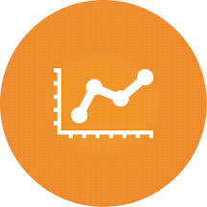

Systems of Engagement (SOE): CRM Is the glue
OMNI-CHANNEL
Connect the Channels
SINGLE VIEW OF CUSTOMER
Connect the Context
z
PERSONALIZATION
Connect to the Customer
SOCIAL MEDIA
MOBILE
BIG DATA
DATA QUALITY AND GOVERNANCE
MARKETING AUTOMATION
MULTICHANNEL MARKETING
WEB/ E-COMMERCE
KIOSKS
SOCIAL MEDIA ANALYTICS
PRODUCT/ PRICING ANALYTICS
SOCIAL/ MOBILE COMMERCE AND ENGAGEMENT
PREDICTIVE ANALYTICS
CONNECT THE PLATFORMS
CONNECT THE EXPERIENCES
CLOUD
API
CUSTOMER EXPERIENCE RESEARCH
INTERACTION DESIGN
VISUAL DESIGN
INFORMATION ARCHITECTURE

Slide 11


SALESFORCE Provides a rich SOE environment
SERVICE CLOUD
SALES CLOUD
MARKETING CLOUD
APPLICATION
PLATFORM
Partner Distributor(s)
Org.Salesforce.com
Existing Systems
A
Web Services
Legacy Line of Business apps
B
C
Data Integration & Synch
Data Warehouse
Consumers
(household)
Triggers
(account, contact, oppty, quote, custom…)
Adaptable UI
Analytics / Reporting
Data integration utilities
….
UI toolkits
Notes:
Let us know if you want to say something Deepak ☺

Slide 12
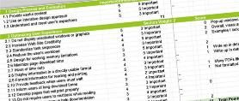
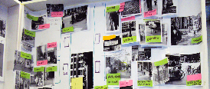
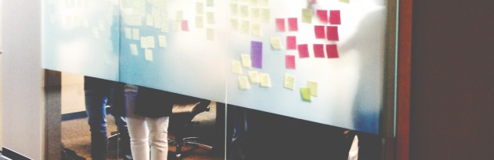
ADITI Roadmap of Services.
1
2
3
STRATEGY DISCOVERY,
USER RESEARCH, VISION
MINIMAL VIABLE PRODUCT DEFINITION & DESIGN
UX, ENGINEERING & MANAGED SERVICES
Current State Analysis
Heuristic & data analysis of existing digital properties on various platforms
Business Aspiration Discovery
Stakeholder interviews to document business goals (Business, IT, Executive)
Consumer User Research
Primary research to reveal consumer attitudes, test & evolve existing segmentation; secondary competitive research TBD
Vision Document
Articulation of Vision & Roadmap resulting from discovery, research & ideation
Engagement Data Model
Define engagement data model & info flow
Minimal Viable Product
Business analysis & requirements for development of each work stream resulting from the Vision document; requirements dig deeper into needs of each persona from the research
Architectural Design Sessions
Development of the best architecture & supporting systems (often involves collaborative sessions)
UX Roadmap
Create concepts to support desired goals; UX is integrated across channels
Agile Engineering
Development resources as planned to enhance existing enterprise team
Managed Services
Support & maintenance services available to ensure smoothest possible on-going operation and improvement

Slide 13
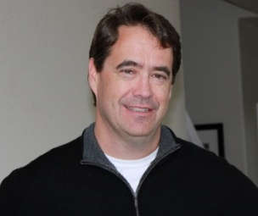
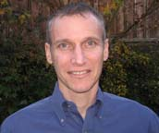
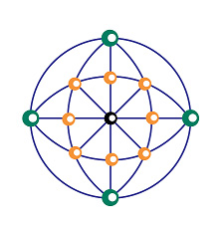
CRM Technology TeaM
Brian Clift has served over the past 20 years as a architect, lead developer, independent consultant and project manager. In the most recent 7 years, Brian has served as a Salesforce.com lead developer, project manager and architect on large, complex and custom projects for companies such as Staples, Hewlett-Packard, Level 3 Communications, Motorola-Mobility, Qualcomm, Citrix and others.
Jonathan has been engaged in technology marketing, product management, and business development for over 20 years and is expert in online services business. He was a Co-Founder VP at Jobster.com; Director at eShop (acquired by Microsoft in 1996), and a Director of Product Management for 8 years at Microsoft.
Brian Clift,
Senior Salesforce
Technical Consultant
Jonathan Weinstein
Business Consultant
A multi-skilled Salesforce professional with good all-round Functional and Technical expertise. Extensive experience on Salesforce - sales cloud, service cloud and force.com platform. Recent experience with clients like Sony, Cognizant, VMWare Currently leading a approx. 20 developer Salesforce team at Sony. Led Salesforce center of excellence team at HCL, grew team from 1 to 150 member team.
Experience in End to End Implementation, Integration and Production Support. Proficient in using Apex and VisualForce. Experience in migrating data using Data Import Wizard and Data Loader. Profound knowledge in Workflow Rules, Validations and Formulas in Salesforce.
Onkar Kumar
Senior Salesforce Architect
Chandra Kanth
Salesforce Developer

Slide 14
THANK YOU.

